Slide 1

Smart Identity Management Platform Layout
Brittany Jacques
Debolina Mukherjee
Glenn Kees
Jaime Barragan
Paul Rodriguez

Slide 2

Hypothesis
The identity of an individual using well-know or verifiable evidence is key for recognition. In today’s world, the most efficient way of storing and accessing this information is in digital form. This project hypothesizes that using “Smart Identity” documents powered by blockchain we can create a universal and secure platform for users to manage and exchange this verifiable evidence.

Slide 3

Motivation & Goal
Motivation behind this project was to establish a safe and dependable way to keep sensitive information stored on a blockchain.
This was achieved by creating a smart contract that can store/change/remove any information that as deemed fit to build or a digital identity

Slide 4

Summary
Front-end Web UI developed using Streamlit
ERC721 (NFT) Smart Contract implemented using Solidity
Web3 integration with Python for communication with Blockchain
Pinata for convenient integration of document media with IPFS

Slide 5

Data Exploration & Clean up
Streamlit discussion boards were used throughout the creation of front-end UI.
Polygon test net was considered for off chain test deployment. Due to unforeseen complexity, we opted for local development.
Consideration for adding payable/paywall features was not possible due to time constraints.

Slide 6


DEMO
Notes:
Glenn

Slide 7

Results & Conclusions
We were successful with creating a platform for storing PI documents in a secure digitized format by involving the concept of blockchain.
The concept holds promise for future exchange of PI in secured platform. However, recipient organizations need to have infrastructure in place to enable this fully.

Slide 8
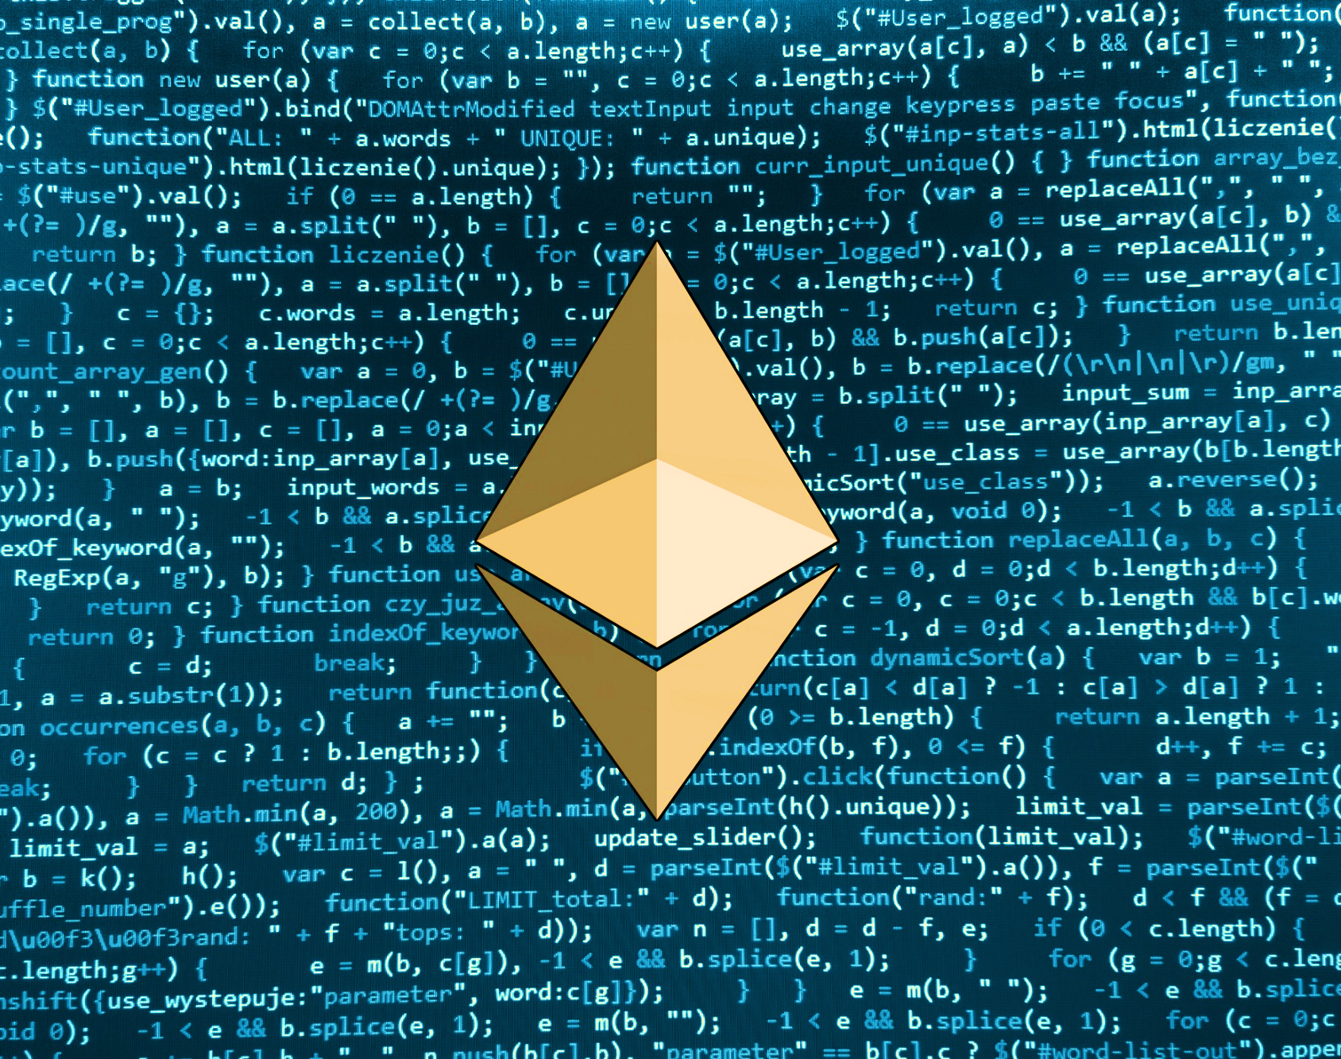
Next Steps
Enhanced authentication and sign up
Verification for scanned documents
Additional encryption as needed
Payment gateway for exchange and funding
Enhanced web framework capabilities

Slide 9

Questions

